Slide 1
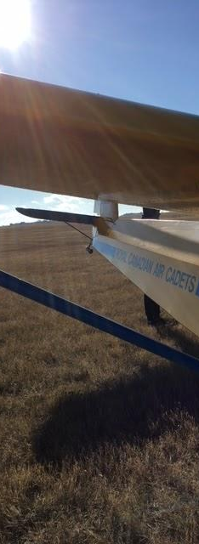
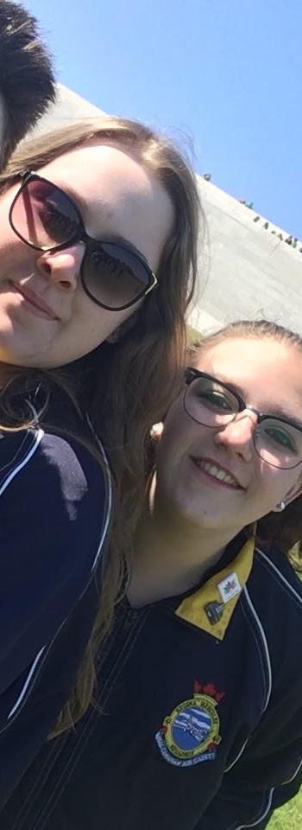
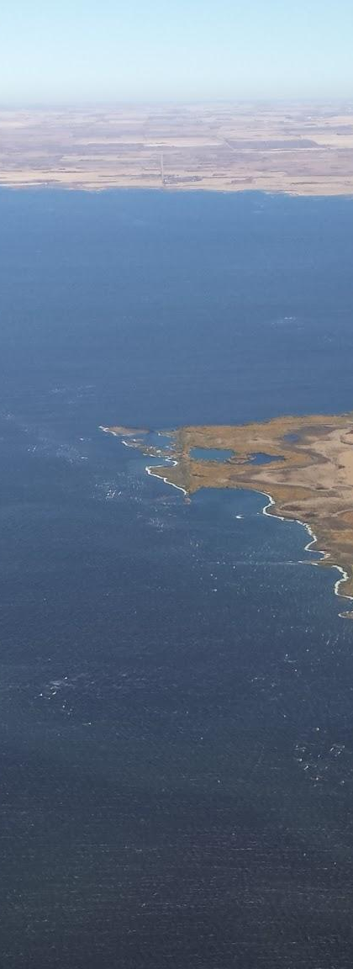
SK Provincial Committee 2017 Photo Contest
Air Cadet League of Canada

Slide 2
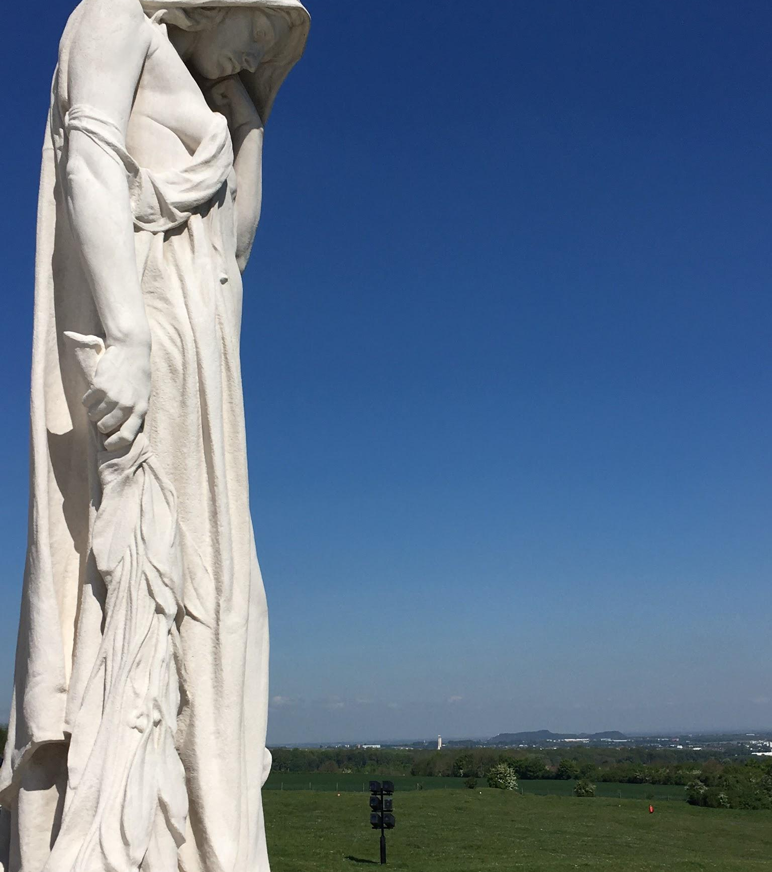
Notes:
Left side image: Title “Cadets at Vimy Ridge” Flight Sgt Allison Bennett - #41 Hercules Category 3 Cadets - 4th to 7th year
Right Side Image: Title “Mother Canada” Flight Sgt Allison Bennett - #41 Hercules Category 3 Cadets - 4th to 7th year

Slide 3
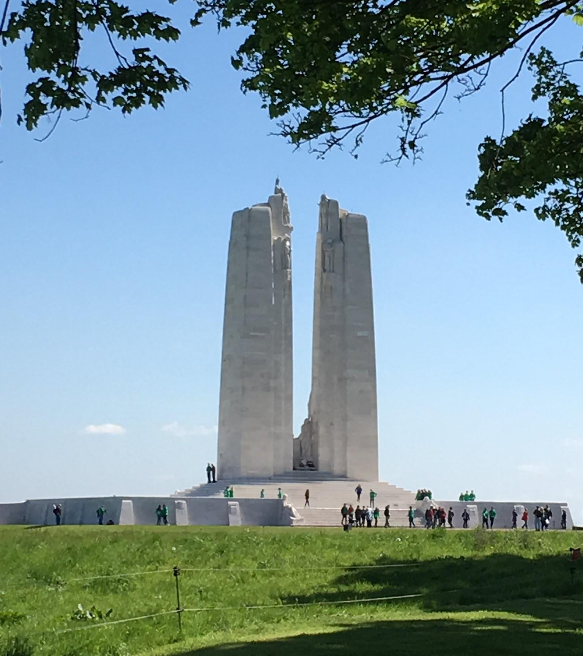
Previous page Left side image:
Entry # 1: Title “Cadets at Vimy Ridge”
Flight Sgt Allison Bennett - #41 Hercules
Category 2 Cadets - 4th to 7th year
Previous page Right Side Image:
Entry # 2: Title “Mother Canada” Flight Sgt Allison Bennett - #41 Hercules
Category 2 Cadets - 4th to 7th year
Current page Right Side Image:
Entry # 3: Title “Vimy 100” Flight Sgt Allison Bennett - #41 Hercules Category 2 Cadets - 4th to 7th year

Slide 4
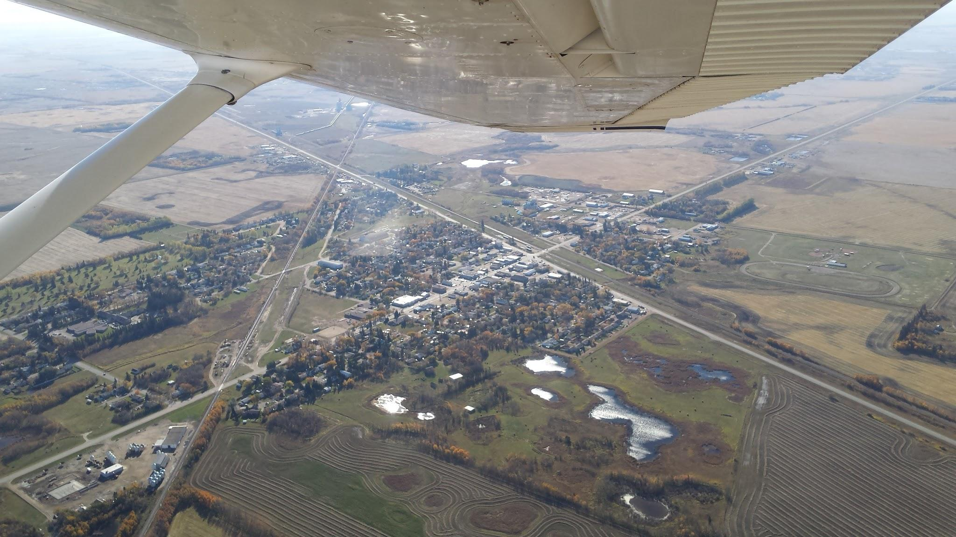
Entry # 4: Title “Cruising above Wadena”
Cadet Joshua Mendoza - #542 RCACS
Category 1 Cadets - 1st to 3rd year

Slide 5
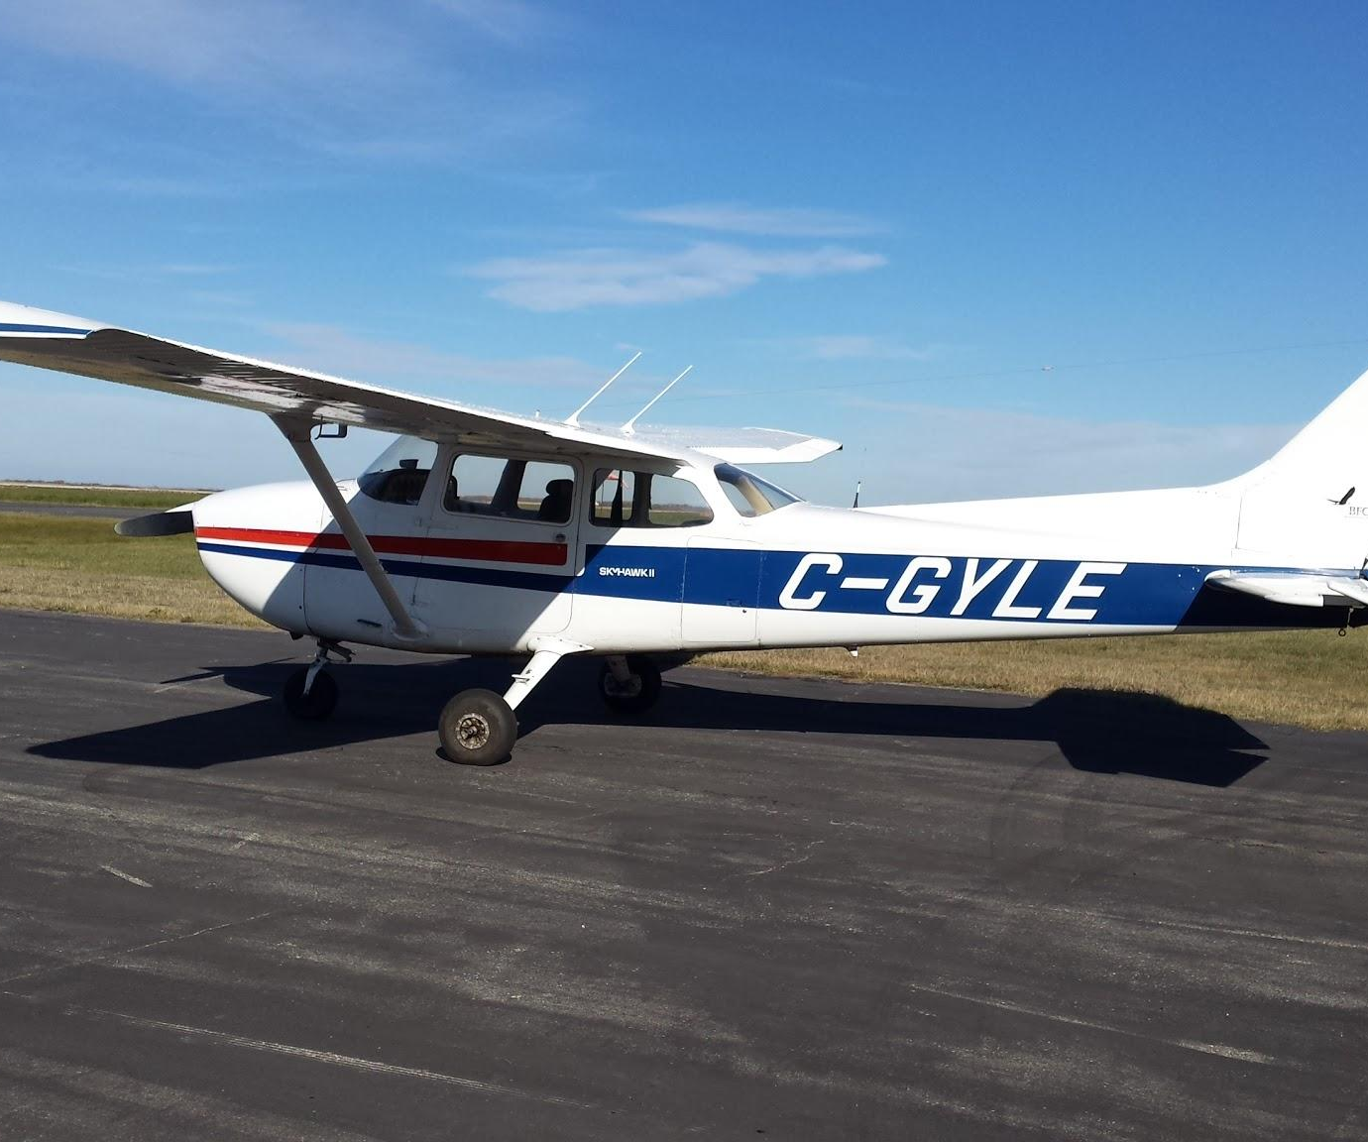
Above Entry # 5: Title “Soaring above the Quill Lakes”
Right Entry # 6: Title “Glimpse of a Cessna”
Cadet Joshua Mendoza - #542 RCACS
Category 1 Cadets - 1st to 3rd year

Slide 6
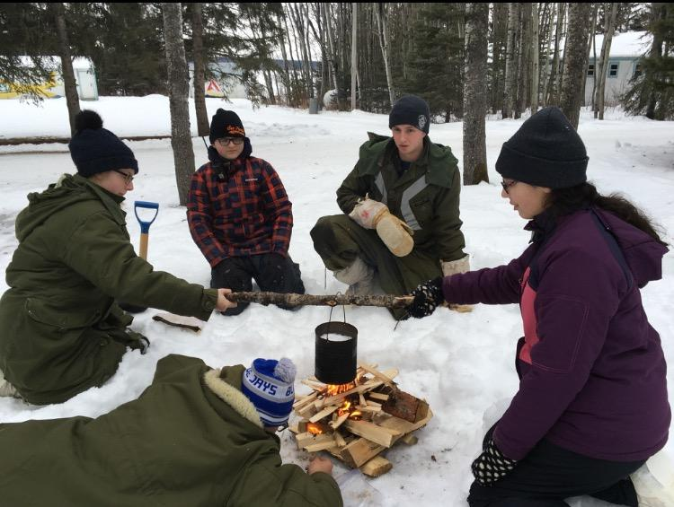
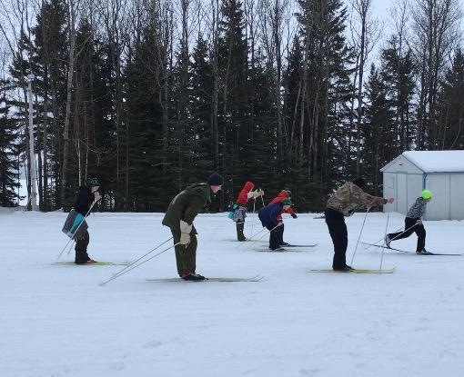
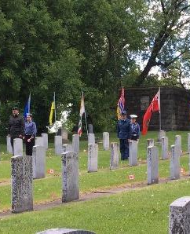
Left Entry # 7: Title “Fire building Teamwork”
Above Entry # 8: Title “Saskadet Ski race”
Right Entry # 9: Title “Decoration Day”
Lt Brenda Dyer - #38 Anavets
Category 3 Adults

Slide 7
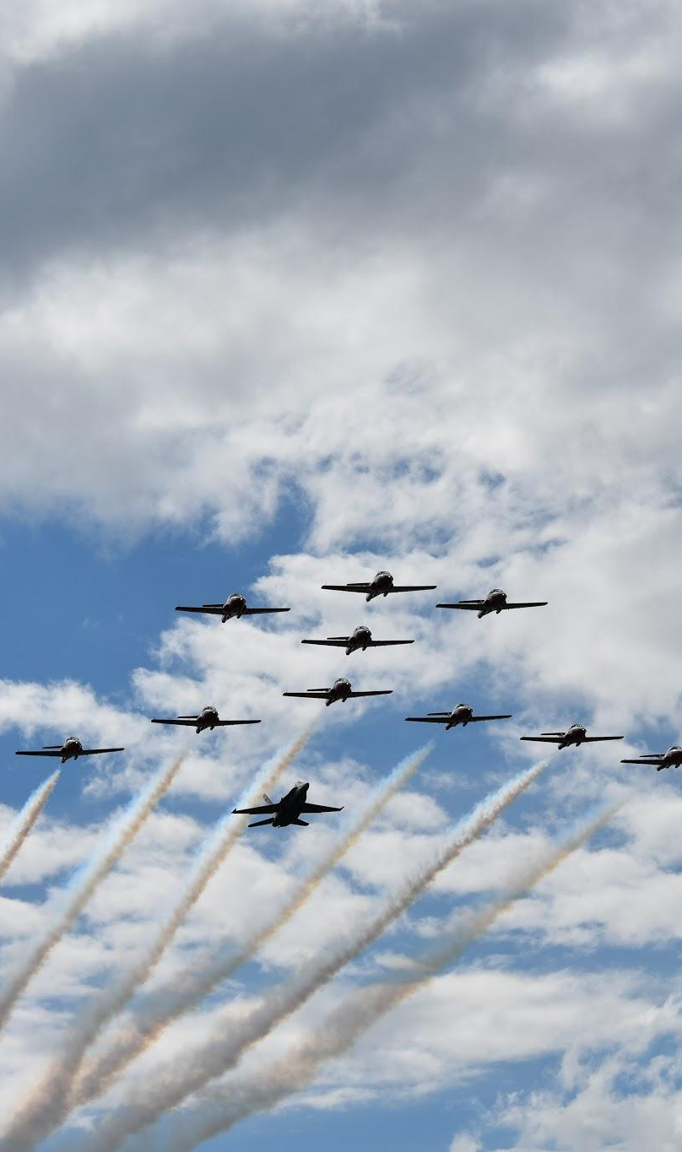
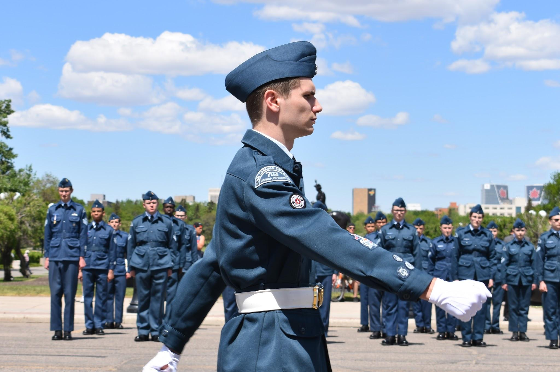
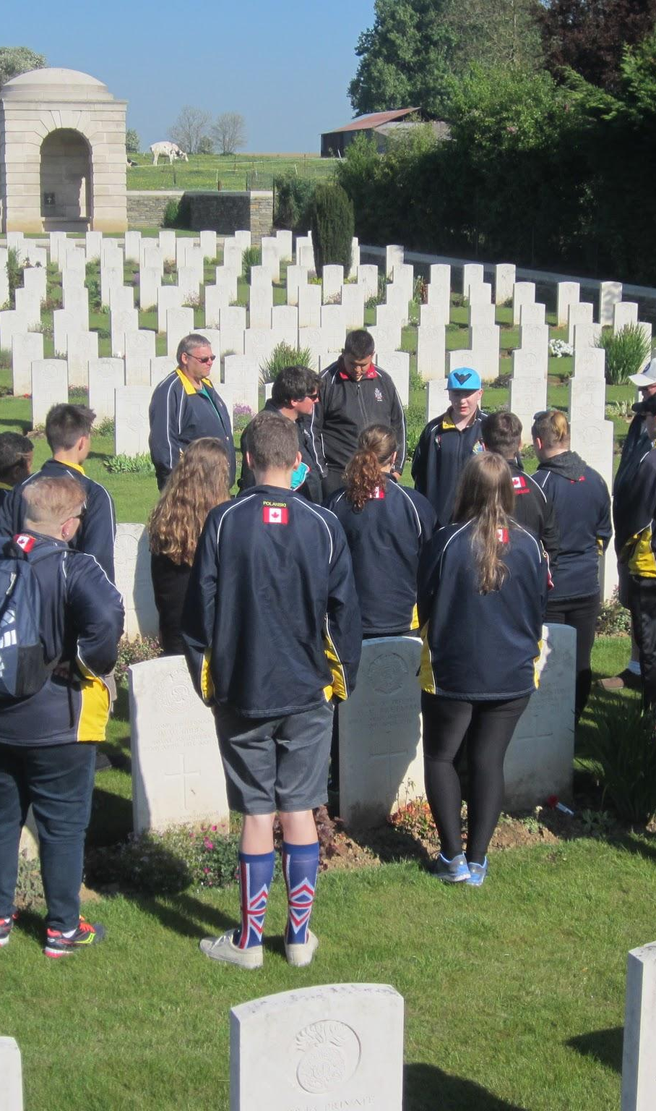
Left Entry # 10: Title “Canada 150 Remembers our heroes”
Above Entry # 11: Title “Regina Air cadets 75th Anniversary Parade”
Right Entry # 12: Title “We will remember them”
Leslie Bennett - #41 Hercules
Category 3 Adults

Slide 8
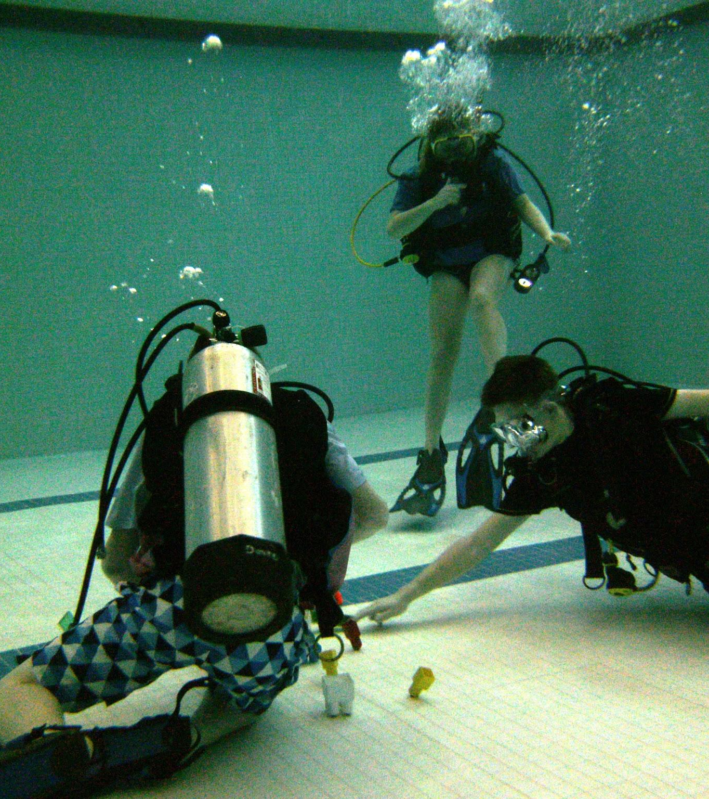
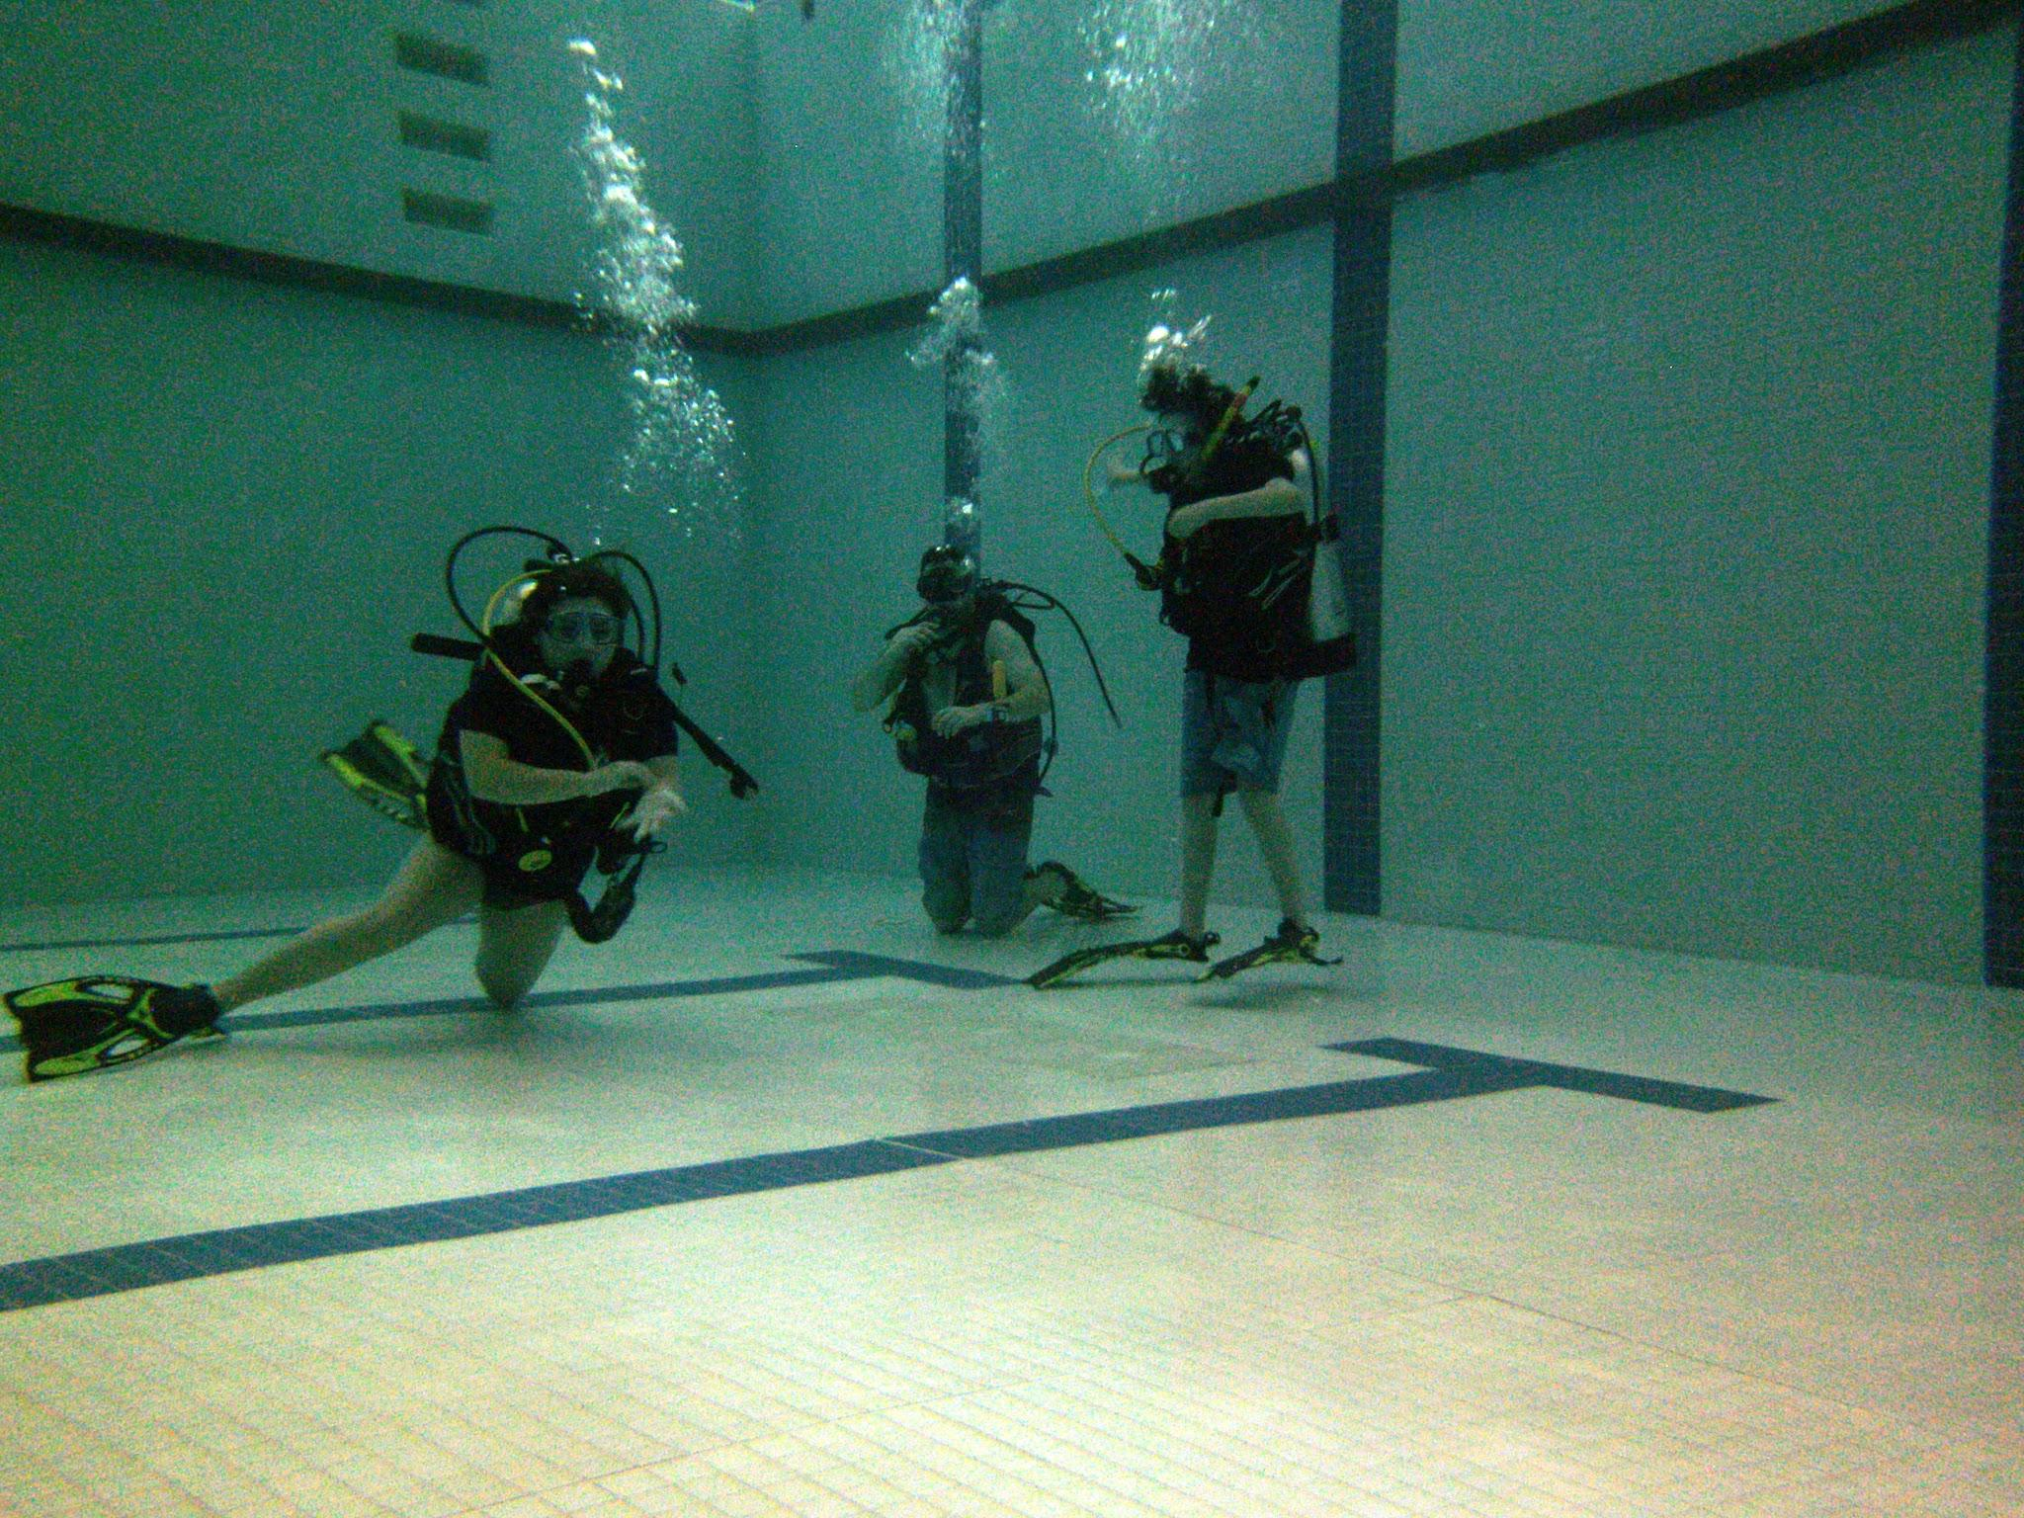
Left Entry # 13: Title “Scuba 1”
Right Entry # 14: Title “Scuba 2”
Dennis McCullough / Capt Joyce Ptoleny - #43 RCACS
Category 3 Adults

Slide 9
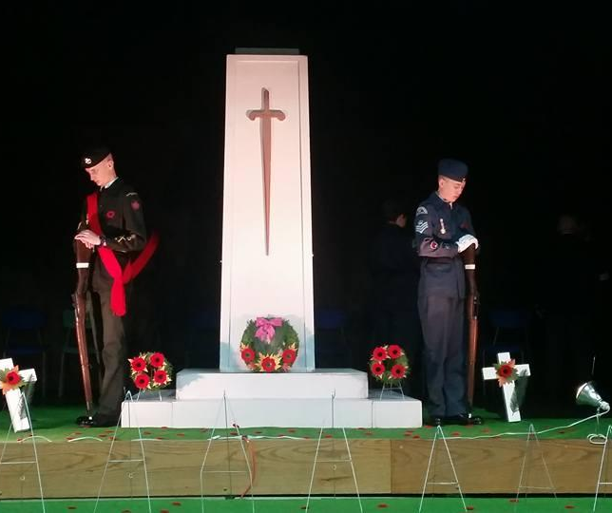
Left Entry # 15: Title “Remembrance Day”
Above Right Entry # 16: Title “In Honor (Black & White)”
Below Right Entry # 17: Title “Honor Guard”
CI Shaileen Hall - #43 RCACS
Category 3 Adults

Slide 10
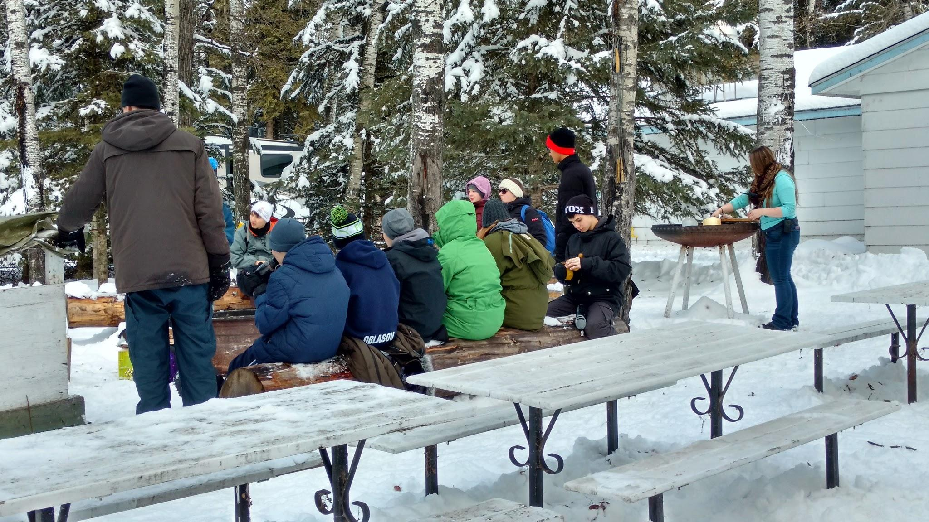
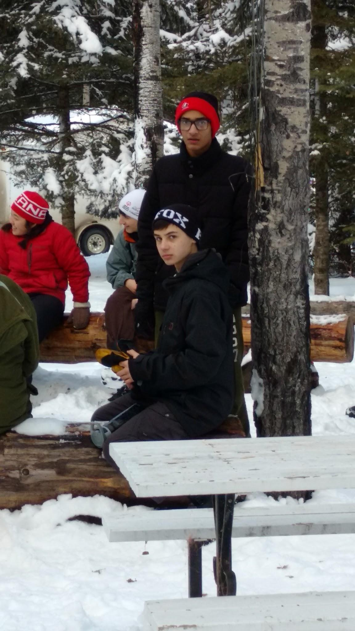
Above Entry # 18: Title “Winter Survival at Saskadet 1”
Right Entry # 19: Title “Winter Survival at Saskadet 2”
Flt Corp Matthew Spilak - #41 Hercules
Category 1 Cadets level 1st to 3rd yr

Slide 11
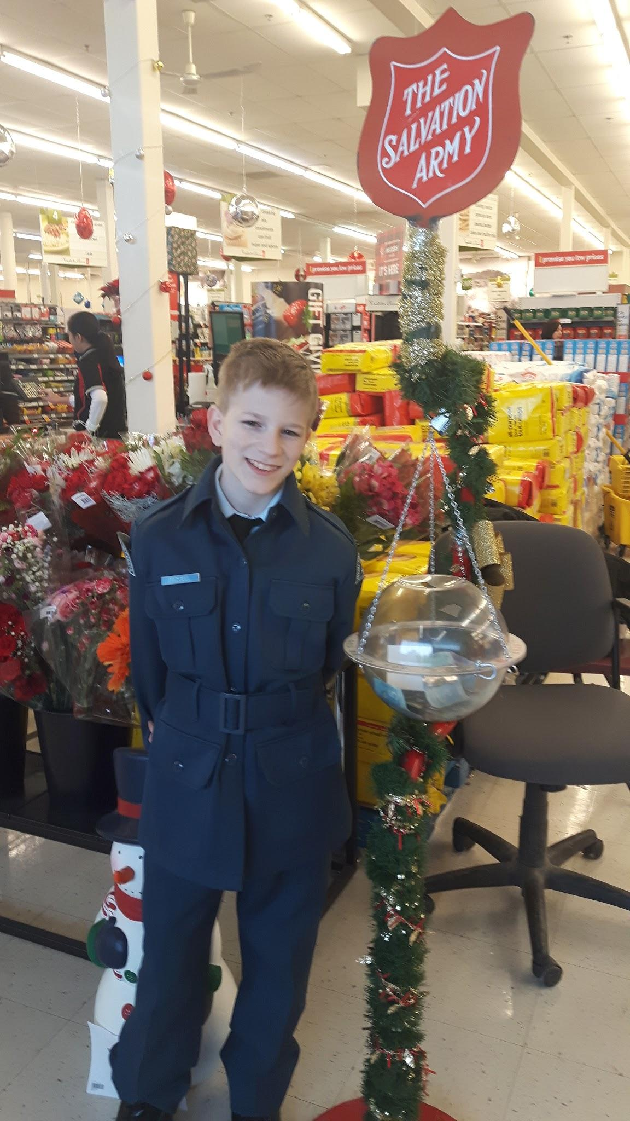
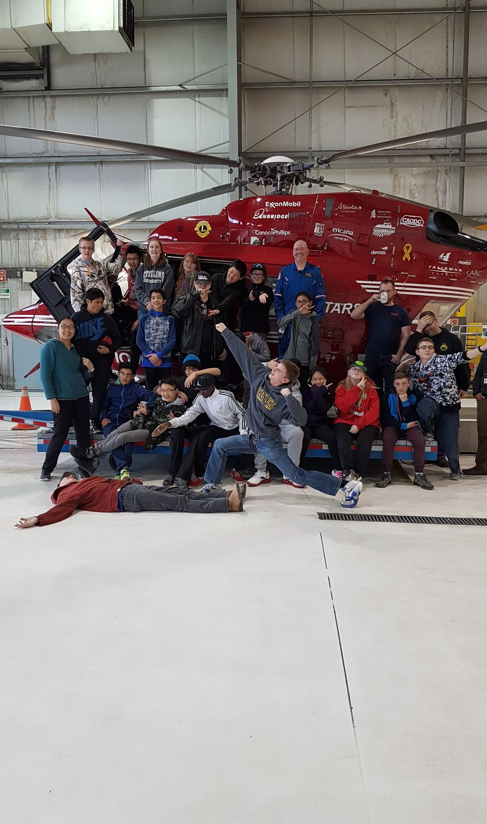
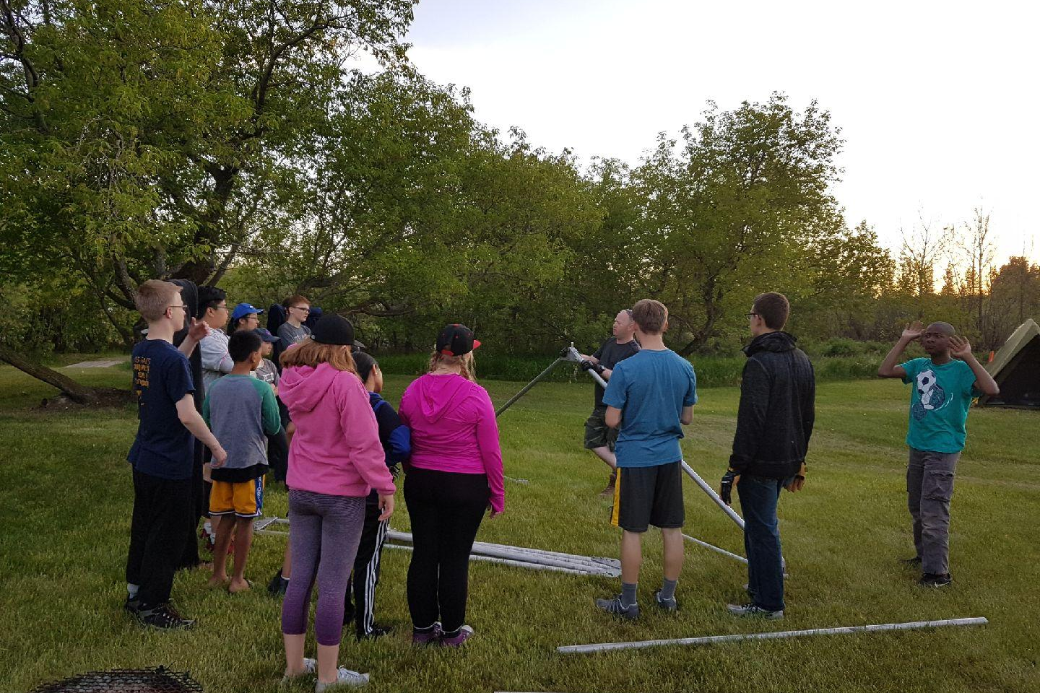
Left Entry # 20 : Title “untitled” sent in by Lisa Tadgell - Category 3 Adult
Centre Entry # 21: Title “703 with Stars” sent in by Charlotte Harris - Category 3 Adult
Above Entry # 22: “FTX Campout” sent in by Capt Chris Selensky - Category 3 Adult

Slide 12
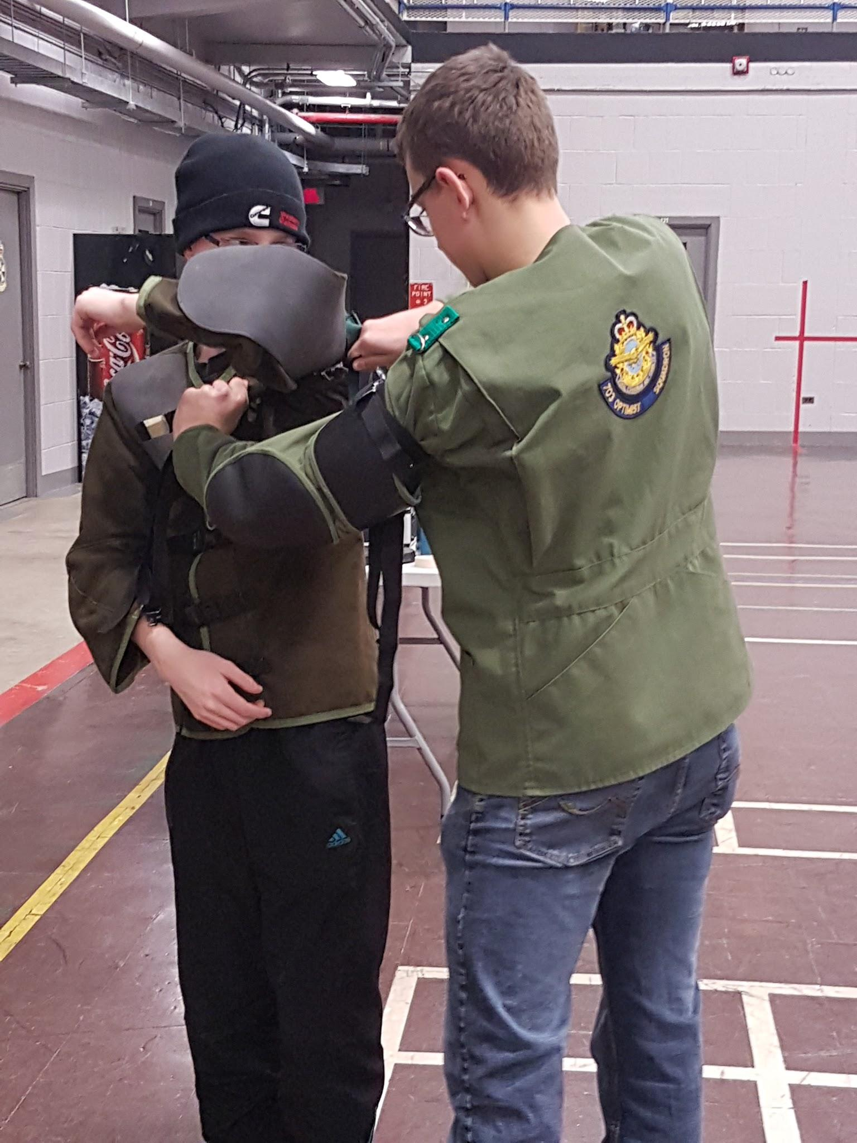
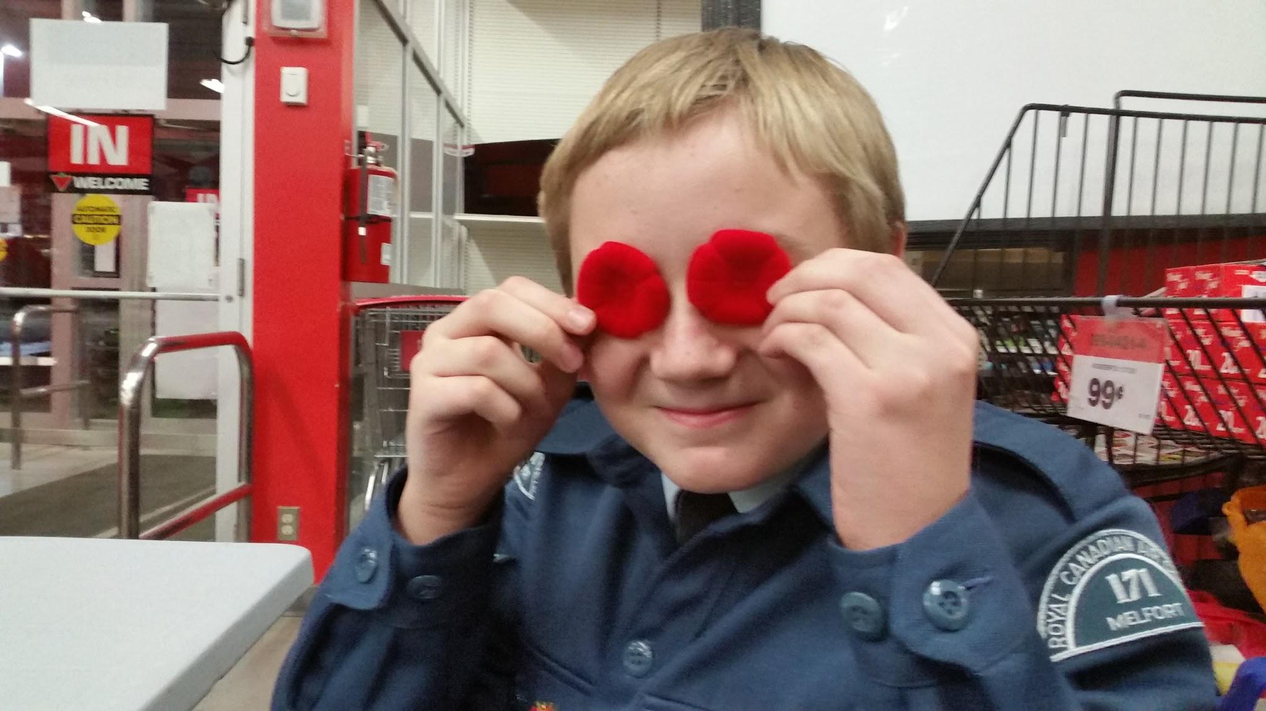
Left Entry # 22: Title “Get ready for range” sent in by unknown
Right Entry # 23: Title “unknown” sent in by unknown

Slide 13
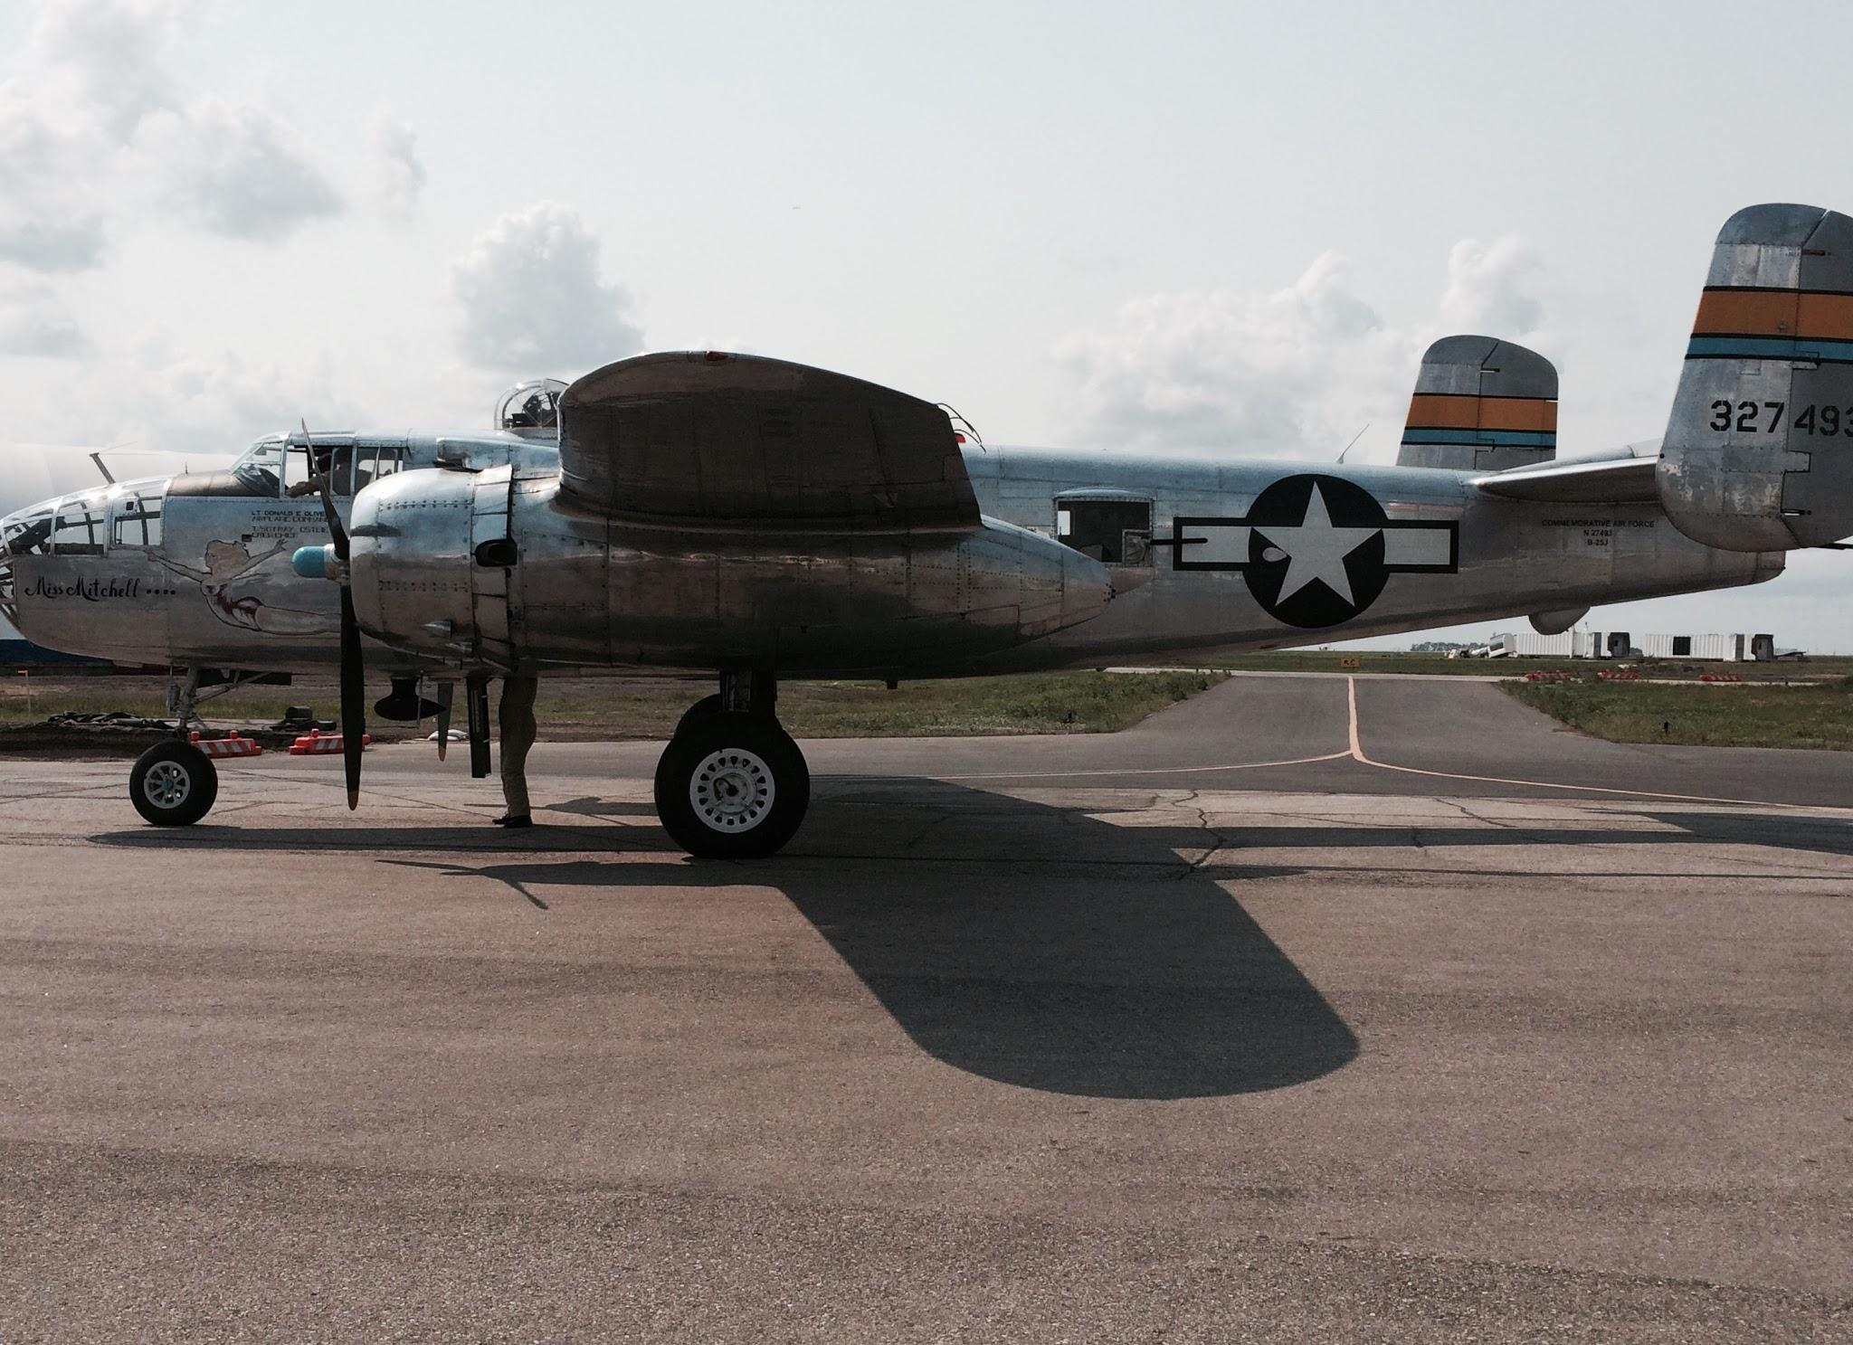
Left Entry # 24: Title “Gliders sunrise” submitted by Cdt Sofia Vasiutynska - #41 Hercules Category 1 - 1st to 3rd Yr
Above Entry # 25: Title “WWII B-25 Bomber visits the Queen City” submitted by Cdt Caelan Morrow - #41 Hercules Category 1 - 1st to 3rd Yr

Slide 14
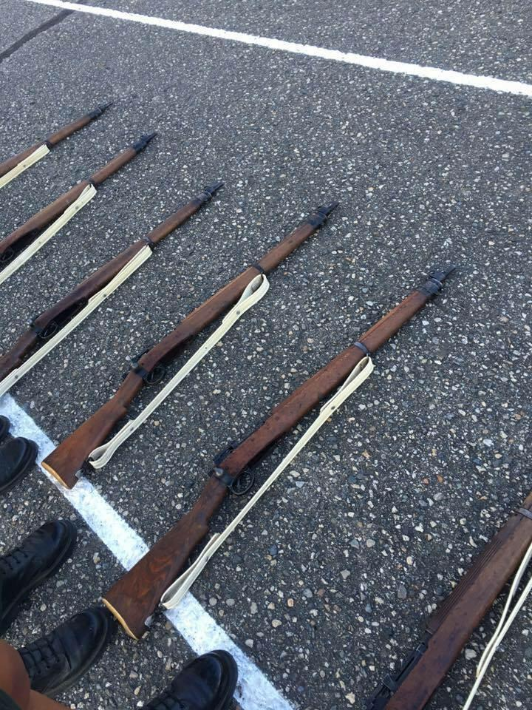
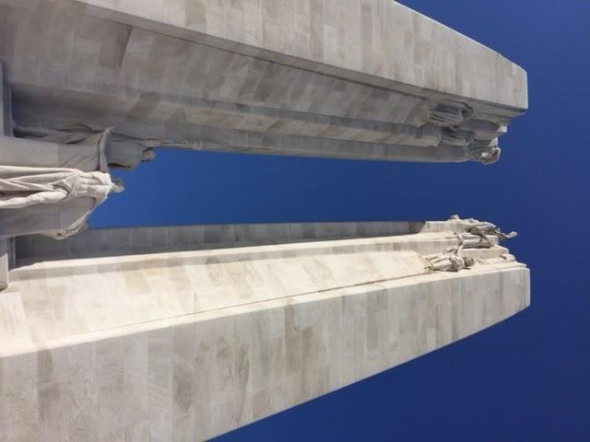
Left Entry # 26: Title “Blue Skies over Vimy” submitted by Captain Kim Drew - #41 Hercules Category 3 Adult
Right Entry # 27: Title “La feu de joie” submitted by Flt Sgt Leighanne Bousfield - #41 Hercules Category 2 Cadets 4th to 7th Yr
Translated “fire of joy”

Slide 15
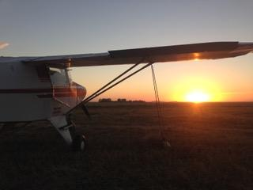
Entry # 28: Title “unreadable” sent in by Craig Dale - Category 3 Adult

Slide 16
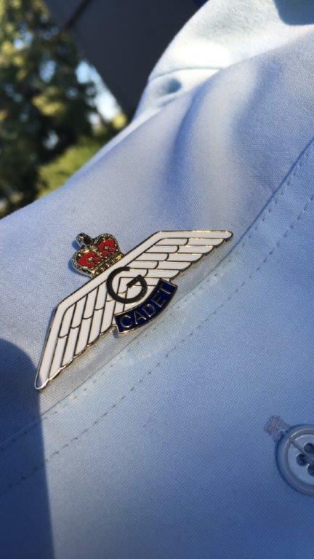

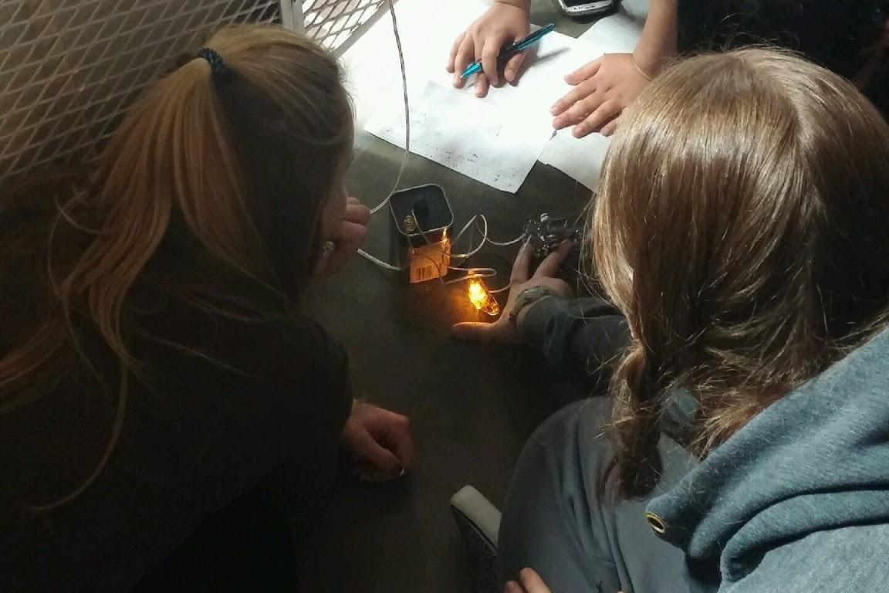
Left Entry # 29 : Title “What the fuss is about” sent in by Lisa Susanna Heinrich - Category 3 Adult”
Centre Entry # 30: Title “Silhouette” sent in by Flt Sgt Andrew Soch - Category 3 #40 Snowbird Category 2 4th to 7th yr
Above Entry # 31: “Learning Morse code” sent in by C Harris Category unknown

Slide 17
Entry # 32 : Title “Flyby at ACR 1” sent in by Capt Joyce Ptolemy - Category 3 Adult”

Slide 18
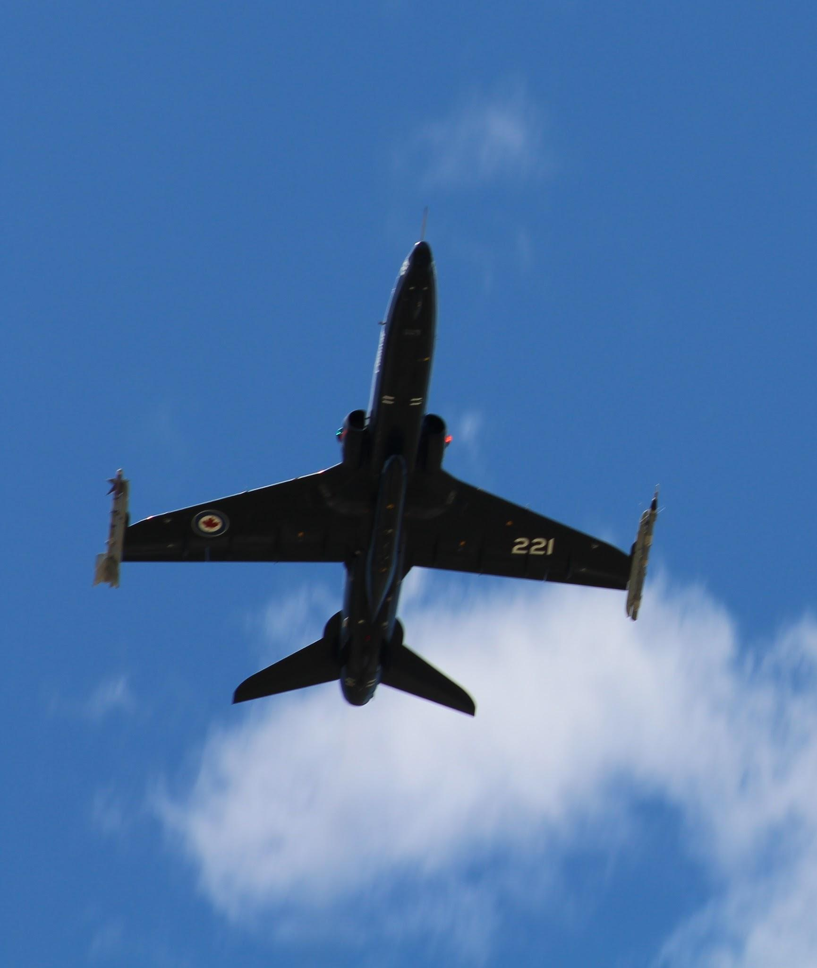
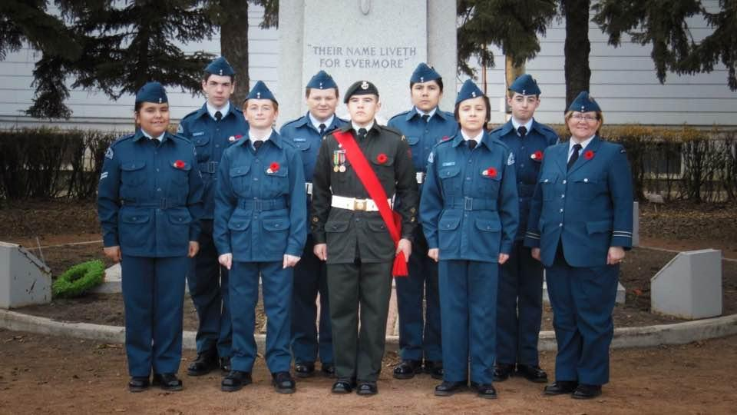
Entry # 33 : Title “Flyby at ACR 2” sent in by Capt Joyce Ptolemy - Category 3 Adult”
Entry # 34 : Title “Laying Wreathes” sent in by Capt Joyce Ptolemy - Category 3 Adult”

Slide 19
Entry # 35 : Title “Flags for Flyby” sent in by Capt Joyce Ptolemy - Category 3 Adult”

Slide 20
THANK YOU EVERYONE FOR PARTICIPATING IN THIS YEARS PHOTO CONTEST

